Slide 1
Water Erosion Prediction Project
Team 5: Swept Away
Date: 2/14/2019

Slide 2
Cognitive Walkthrough

Slide 3
Users & Environment
High school students
Using WEPP app to discover effects of erosion in their area
High school teachers
Using WEPP app to help students gain a better understanding of erosion
Soil Erosion Enthusiasts
Using WEPP app out of curiosity
Scientist Team
Looking at the data input into the app to compare to their own data
Our Team
The team wants the app to work to its best standards
Michigan
Most students will likely be from Michigan due to both Mary’s team and ours being located within the state
Houghton, MI
Students in our area would be the idea test group
Areas with Cellular Data
Students must be able to access internet on their mobile devices to use web app

Slide 4
Use Scenario Description
Scenario 1: Nominal Task Performance
Sarah Myer : Geology Teacher from DeWitt
Excited to teach her students about the effects of plant cover during their lesson on erosion, she opens the app and demonstrates the model using input reflecting the local area. After entering the values, she presses the calculate button and shows her students the displayed prediction values. She then enters a new query and changes the percentage of ground cover entered, showing the class the new values from the model and comparing it to the previous query to highlight the impact.
Scenario 2: Error Handling
Joshua Bates : Senior at L’Anse High School
As part of his AP environmental science class, he and his fellow classmates are collecting data to model erosion outcomes. Unfortunately, he doesn’t entirely understand the input method and types characters into the data fields. After pressing the calculate button a message pops up explaining that there has been an error in input and directing him to enter a number from 0-100 for the percentages and an integer for the slope.

Slide 5
Prototype Views
Current application in use that we’re basing our application on
https://forest.moscowfsl.wsu.edu/cgi-bin/fswepp/wd/weppdist.pl
Types of prototype views
Default landing page
Results page
Results page with multiple outputs

Slide 6
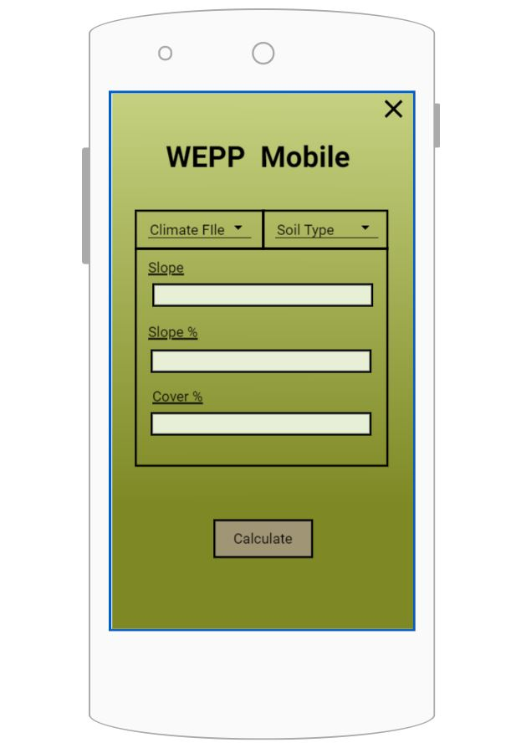

Slide 7
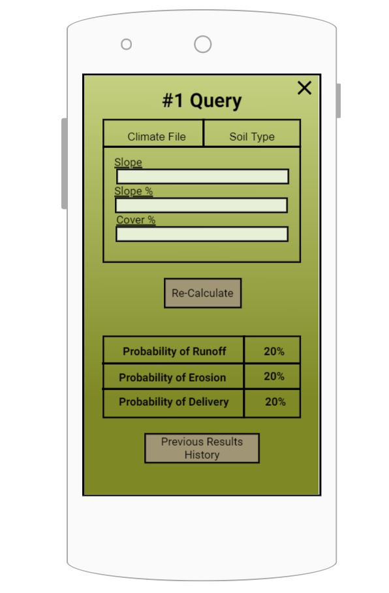

Slide 8
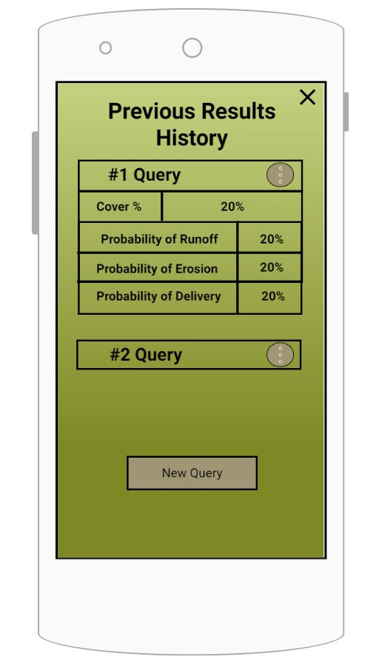

Slide 9
Usability Goals and Concerns
Goals:
Easy, intuitive interface for high school students
Quick and responsive to actions
Concerns:
High school teachers that are technologically challenged
The many parameters may result in a busy or confusing layout
Confusion about terminology and which units should be used

Slide 10
Questions

